Slide 1

End to End Sales Prediction Solution for Retail Stores
Submitted by
Priyanka verma

Slide 2
Project Overview
“This is sales forecasting project for Rossmann Pharmaceuticals. The finance team aims to predict sales across all stores in various cities, six weeks in advance.”
Objective - Deliver an end-to-end predictive solution to help the finance team plan effectively.
Data Context: The dataset includes various factors affecting sales, such as promotions, competition, holidays, seasonality, and store locality. A complete list of fields includes sales, store characteristics, holiday indicators , promotions and competitor data.

Slide 3
Task 1 Customer Purchasing Behaviour Analysis
SUMMARY OF DATASETS :
Training Data (train.csv)
Rows: 1,017,209 Columns: 9 ‘No null values were observed“
Store Data (store.csv)
Rows : 1115 Columns : 10 “Contain store – specific details”
Test Data ( test.csv)
Rows : 41088 Columns : 8 “ Target variable is absent in test dataset “

Slide 4
Data Preprocessing
Merged train and store dataset
train=train_data.merge(store_data,
on='Store', how='left’)
Cleaned dataset after merging them
for further process
Merged test and store dataset
test=test_data.merge(store_data
, on='Store', how='left’)
Cleaned dataset after merging them for further process

Slide 5
Feature Extraction
train_data['Year'] = train_data['Date'].dt.year
train_data['Month'] = train_data['Date'].dt.month
train_data['Day'] = train_data['Date'].dt.day
train_data['WeekOfYear'] = train_data['Date'].dt.isocalendar().week
train_data['DayOfWeek'] = train_data['Date'].dt.dayofweek
train_data['IsHoliday'] = train_data['StateHoliday'].apply(lambda x :1 if x !='0' else 0)
test_data['Year'] = test_data['Date'].dt.year
test_data['Month'] = test_data['Date'].dt.month
test_data['Day'] = test_data['Date'].dt.day
test_data['WeekOfYear'] = test_data['Date'].dt.isocalendar().week
test_data['DayOfWeek'] = test_data['Date'].dt.dayofweek
test_data['IsHoliday'] = test_data['StateHoliday'].apply(lambda x :1 if x !='0' else 0)

Slide 6
Feature Engineering for feeding the train and test data
# Add lag features (past sales for the last 6 weeks)
for lag in range(1, 7): # Lag for 1 to 6 weeks
combined_data[f'Lag_{lag}'] = combined_data.groupby('Store')['Sales'].shift(lag * 7)
# Add rolling features (mean and sum over the last 6 weeks)
combined_data['Rolling_Mean_6w'] = combined_data.groupby('Store')['Sales'].transform(
lambda x: x.shift(1).rolling(window=6*7).mean()
)
combined_data['Rolling_Sum_6w'] = combined_data.groupby('Store')['Sales'].transform(
lambda x: x.shift(1).rolling(window=6*7).sum()

Slide 7
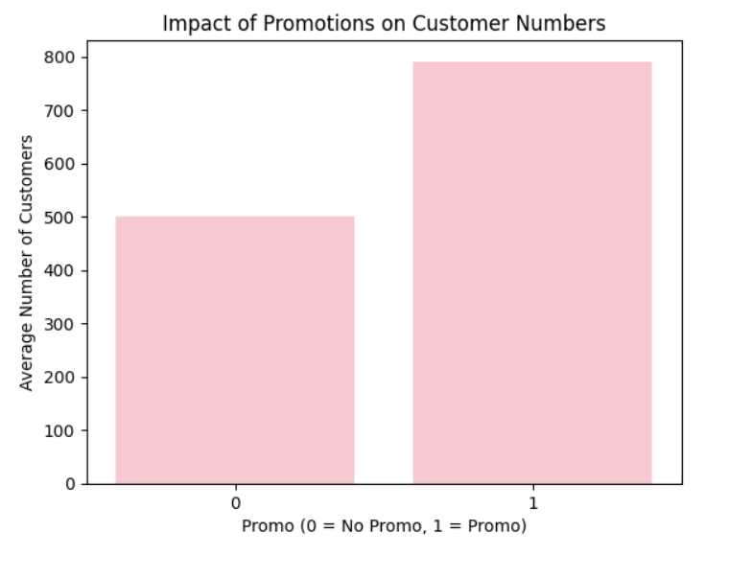
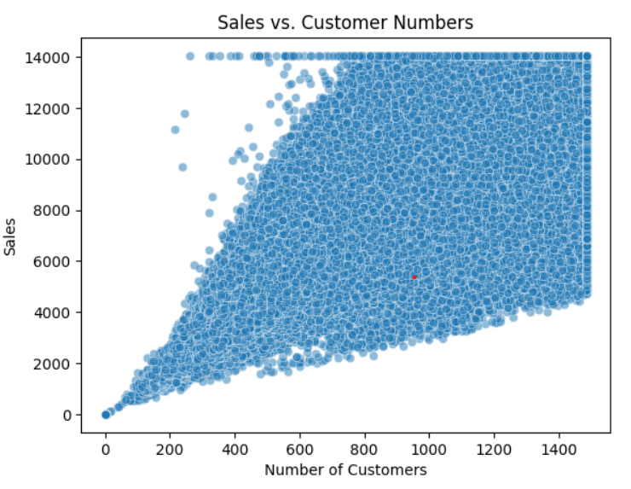
Exploratory Data Analysis Task 1 (Customer Purchasing Behavior Analysis)
Customer will increase when promo are active as compare to non promo
Promotions are direct approach for increasing sales through the customers
Sales completely depend of customers both are dependent to each other scatter plot shows positive correlation between them

Slide 8
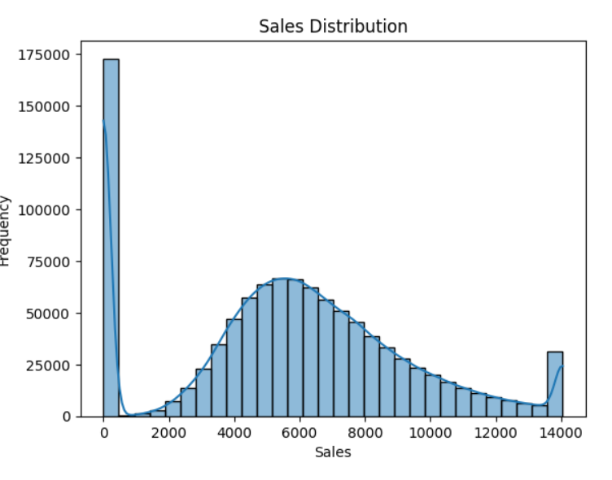
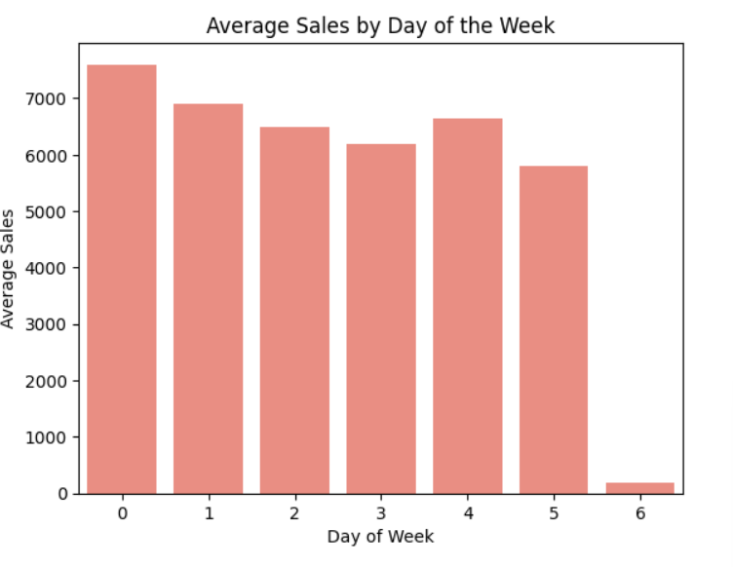
Exploratory Data Analysis Task 1 (Customer Purchasing Behavior Analysis)
Sales Distribution is showing zero sales when stores are may be close or end of promos. Absence of customers.
Customers visit stores mostly on Monday stores average sales will display this but on Sunday may be due to holiday sales are minimum

Slide 9
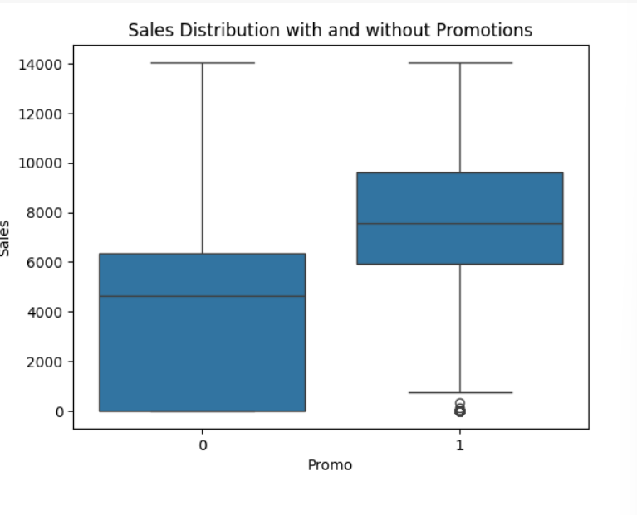
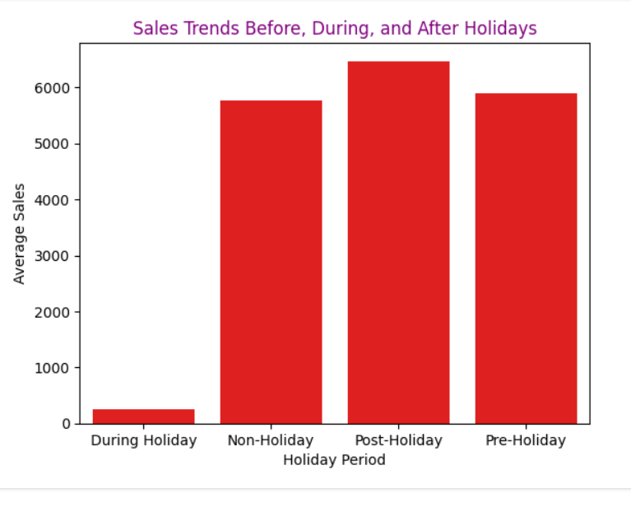
EDA(Cont.)
Sales depends on customers and customers depend on promotions .This barplot is shown high sale only when promotions active in stores
Customers sales trend is clearly visible by the barplot of holiday periods vs sales mostly pharma related stores sales minimum during the holidays as compare to post holiday, non holiday and pre holidays

Slide 10
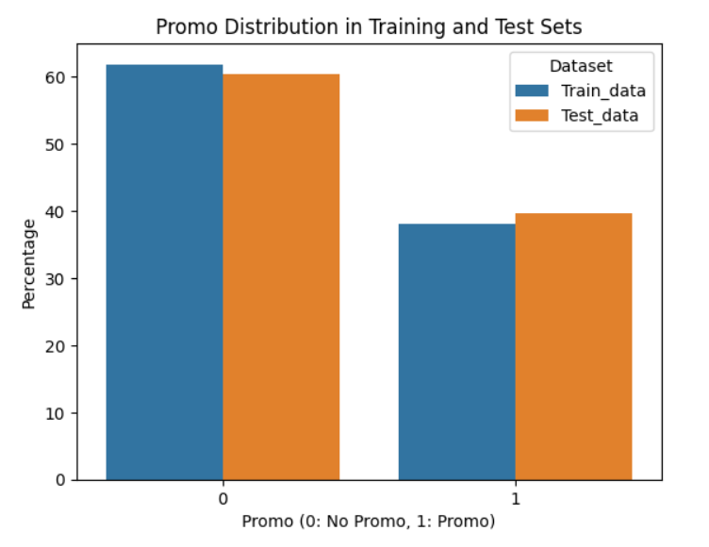
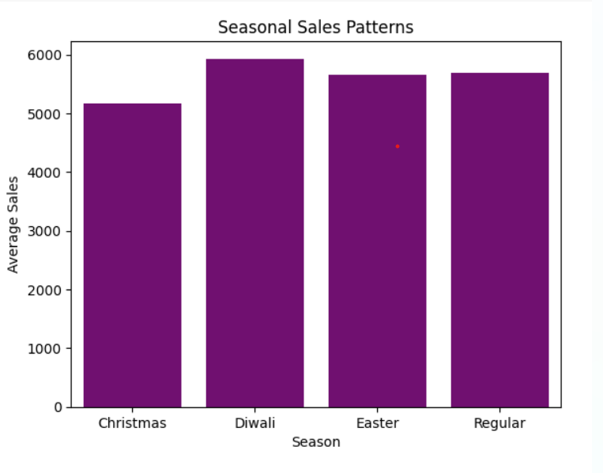
EDA(cont.)
This bar plot is shown seasonal trends of customer purchasing behavior. On easter and regular days sales are equal may be this time weather is remains normal but on Diwali and Christmas these festivals arrive on winter’s peak this time weather changes affect humans directly due to this reason sales increased .

Slide 11
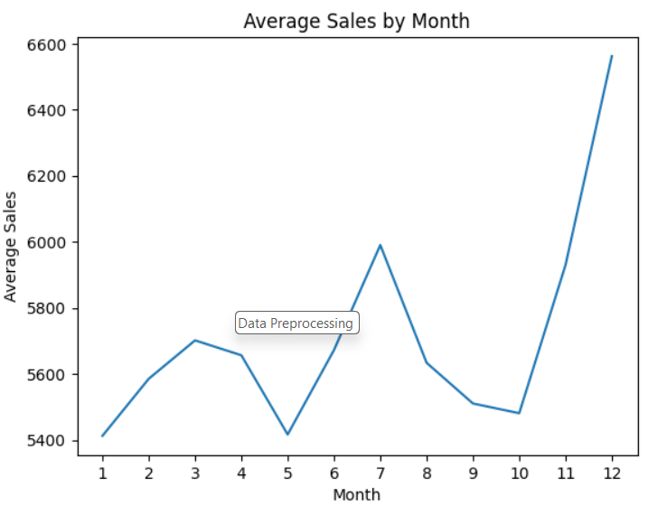
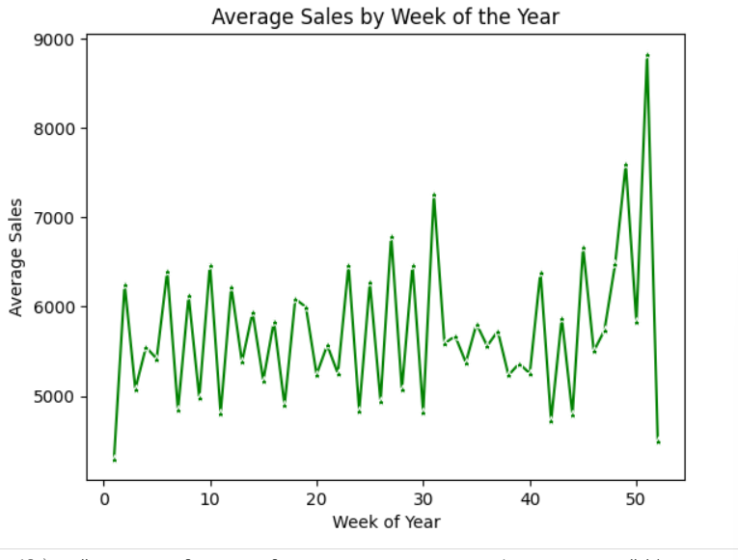
Examine Trends Over Time
Analyze monthly and weekly trends for additional seasonal insights.
First ,fifth and between nineth and tenth months sales becomes very low as compare to other months specially eleventh and tweleth month sales
Average sales of the weeks during the whole year is showing similar up and downs but end of the year it goes very high may be due to seasonallity

Slide 12
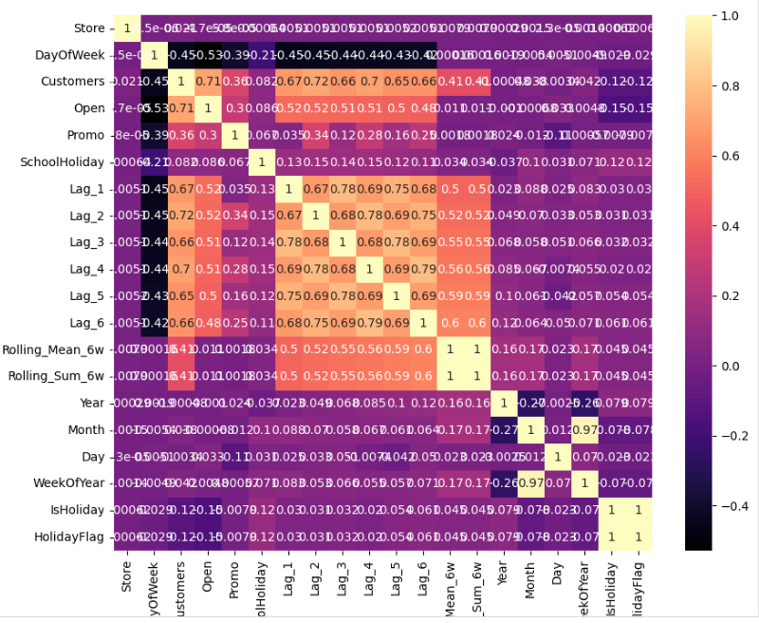
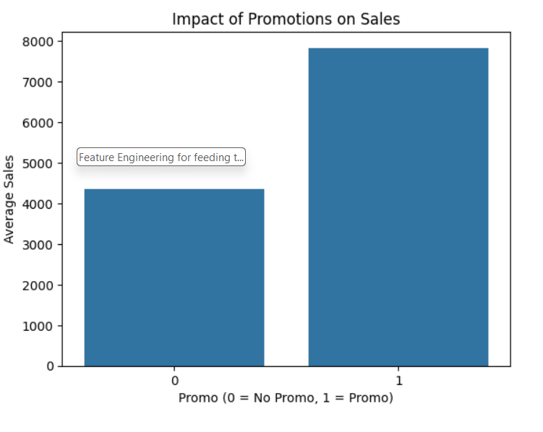
EDA(Cont.)

Slide 13
# Conclusion from EDA
Mondays have most sales since most of the Sundays are closed.
Promotions seem to have a significant effect on sales but not for the number of customers. It is advisable to spend more on promos to get higher returns
Store type b has higher sales and customers per store than other store types. More Store type b must be opened.
4 Assortment b is available only at store type b and it has more sales and customers
than any other assortment. More assortment b must be stocked to meet the
demands of customers.
5. Weekly sales and customers peak at the mid-December. It may be guessed that people buy drugs in advance just before the shops close for the holiday season.

Slide 14
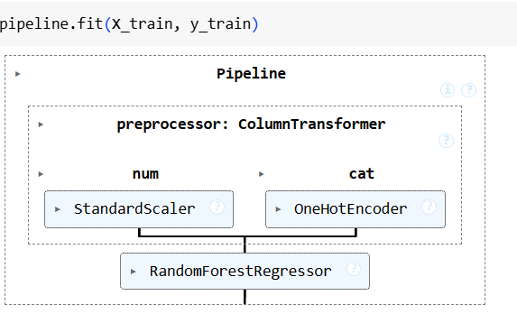
Model Building Using ML
Assumption :
Our models have reliability for a 6-weeks prediction which is sufficient and reasonable to predict the final test set.
Conclusion ● Best model for forecasting for 6-weeks sales. Random Forest Regression algorithm which had an RMSE of 671, R2_ score= 0.96. ● More advanced machine learning algorithms like LSTM have the potential to provide better forecasts, however, they require a longer computation time
Recommendations ● Enrich the data with more information such as pricing, products variety, launch of new products, and location ●

Slide 15
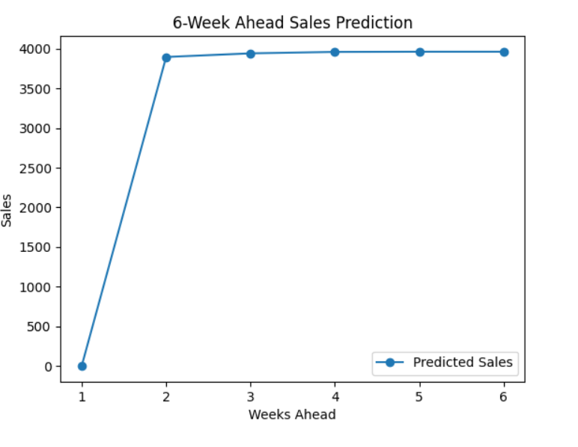
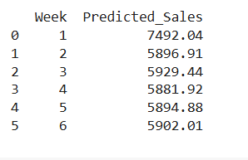
Sales forecasting for six weeks ahead
Conclusion from Modelling
The model built using Random Forest Regressor algorithm is the most accurate one. This can be attributed to higher number of numerical and categorical features in the data.
. Decision tree based algorithms are slightly more accurate than linear regression based algorithms.
. Feature Importance indicating customers , promo and week of year are most important feature of the data.

Slide 16
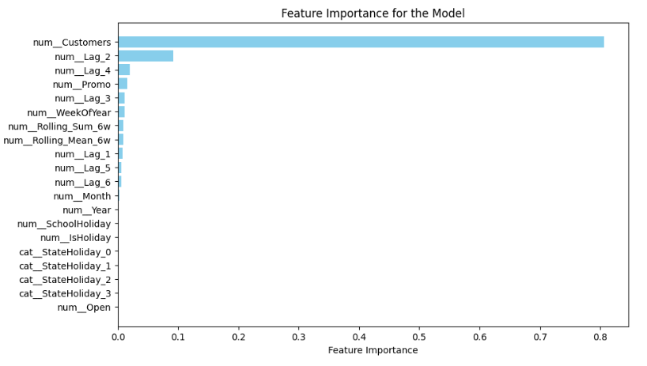
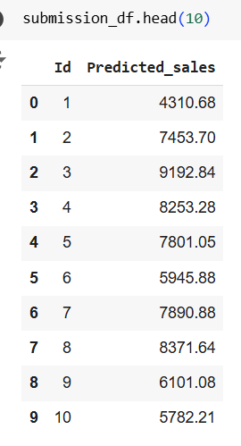
Feature Importance Predicted sales for test data

Slide 17
Logger creation and Deployment
LOGGER CREATION :
# Using joblib I serialize my model .
# create logger on same notebook .
DEPLOYMENT :
# Using flask on my colab notebook .
# to run the flask app externally ( from pyngrok import ngrok)

Slide 18

This Photo by Unknown Author is licensed under CC BY-SA

